Slide 1
Topic: Database Encryption
ITMS 528 Database Security
Hong Zhang

Slide 2
What is covered
Database Encryption Basics:
Definition
Classification
Different Factors for Database Encryption
Encryption Granularity
Encryption Algorithm
Encryption Key
Applications
Oracle
Microsoft SQL Server
MySQL
Third-Party Vendors
Data Encryption’s limitations

Slide 3
Importance for Encryption
Main Methods To Protect Data:
Access Controls
Encryption
Notes:
access controls to gate that should or should not be allowed access to the database, and encryption to protect data at rest.

Slide 4
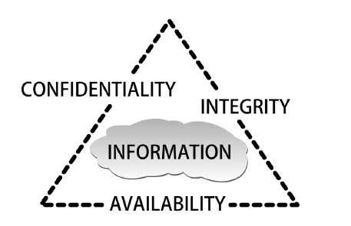
Importance for Encryption
Access Controls
Encryption
A Security Mode for Database Security:
C.I.A. triangle
Notes:
Confidentiality connects with access controls. Integrity points to encryption. Availability means these two methods should not hinder users’ operation.

Slide 5
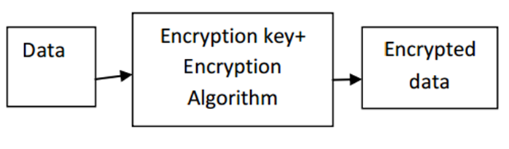
Definition
Encryption: the transformation of data by using sophisticated algorithms in an attempt to make the data unrecognizable
Basic Encryption Processes
Notes:
Data are encrypted using encryption keys and encryption algorithms.

Slide 6
Definition
Database Encryption: Use encryption techniques to transform a plain text database into a whole or partially encrypted database, thus making it unreadable to anyone except those users who hold the encryption keys.
Notes:
Data are encrypted using encryption keys and encryption algorithms.

Slide 7
Classification
Database Encryption
Within Database
Outside Database
Notes:
While performing database encryption, we can encrypt data inside or outside the database.

Slide 8
Classification
DATABASE APPLICATION
DBMS
Encryption Module
Database
Unencrypted
Data
Encrypted
Data
Encryption
Key
Encryption Within Database

Slide 9
Classification
Performer: DBMS
Advantages:
less impact on application environment
can protect against a wide range of threats
Disadvantages:
Encryption keys usually store in the same database
Choice for encryption algorithm is limit
Encryption Within Database

Slide 10
Classification
DATABASE APPLICATION
DBMS
Encryption
Server
(Encryption Key)
Database
Unencrypted
Data
Encrypted
Data
Encryption Outside Database

Slide 11
Classification
Performer: Specialized Encryption Server
Advantages:
Encryption keys and data are separated
Options for encryption algorithm are many
Disadvantages:
Functions of DBMS will be limited after encryption, such as index.
Encryption Outside Database

Slide 12
Encryption Factors
Different Factors affect Database Encryption:
• Encryption Granularity
• Encryption Algorithm
• Encryption Key

Slide 13
Encryption granularity
Page/block granularity
(2) Attribute/column granularity
(3) Record/row granularity
(4) Field granularity (suggest to use)
It is the smallest achievable granularity based on the field of a record.

Slide 14
Encryption Algorithm
Encryption Algorithm:
a mathematical procedure
Basic Encryption Processes

Slide 15
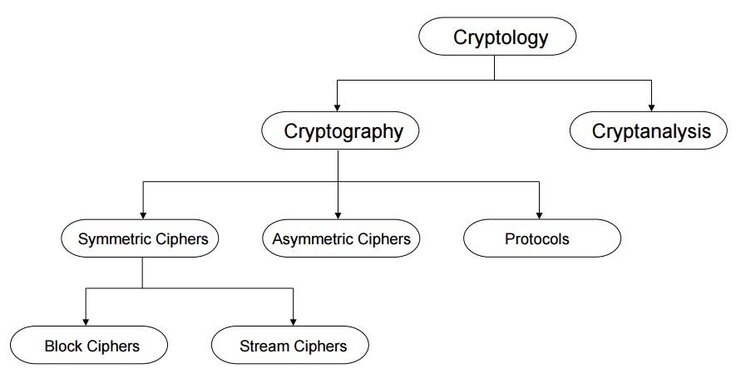
Encryption Algorithm
RSA
DES
3DES
AES
Classification in the Field of Cryptology

Slide 16
Standard Symmetric Algorithms
Algorithm | Type | Key | Strength | DBMS
DES | Block | 56 | Weak | Oracle, MS SQL
3DES | Block | 128 | Acceptable | Oracle, MS SQL
AES-192 | Block | 192 | Strong | Oracle DBMS Crypto, MS SQL, MySQL
AES-256 | Block | 256 | Strong | Oracle DBMS Crypto, MS SQL, MySQL

Slide 17
Encryption Algorithm
Data Encryption Standard (DES)
Encrypts blocks of size 64 bit
Standardized in 1977 by American National Standards Institute
Most popular block cipher for most of the last 30 years.
Nowadays considered insecure due to the small key length of 56 bit
But: 3DES yields very secure cipher, still widely used today
Replaced by the Advanced Encryption Standard (AES) in 2000

Slide 18
Encryption Algorithm
The encryption algorithm of 3DES is:
ciphertext = E_{K3}(D_{K2}(E_{K1}(plaintext)))
Decryption is the reverse:
plaintext = D_{K1}(E_{K2}(D_{K3}(ciphertext)))
3DES extends the effective key length of DES to 112 bites
DES has 2⁵⁶ combinations and 3DES is 2¹¹² or 2¹⁶⁸

Slide 19
Encryption Algorithm
Advanced Encryption Standard (AES)
the most widely used symmetric cipher today
Block cipher with 128-bit block size
Three supported key lengths: 128, 192 and 256 bit
128 bits is quite strong
Assuming one can break DES in 1 second (trying 2⁵⁶ keys in one second), then, trying 2¹²⁸ keys requires 149 Trillion years
Efficiency in software and hardware

Slide 20
Encryption Algorithm
RSA Cryptosystem
the most widely use asymmetric cryptosystem
RSA is mainly used for two applications
1. Transport of (i.e., symmetric) keys
2. Digital signatures
Even though conceptually simple, due to the use of very long numbers, RSA is orders of magnitude slower than symmetric schemes, e.g., DES, AES

Slide 21
Encryption Key
Symmetric key
Asymmetric key
Basic Encryption Processes

Slide 22
Encryption Key
Encryption Algorithms: Asymmetric (left) and Symmetric (right)

Slide 23
Key Management
Cryptographic Access Control
Encrypting objects from different security groups
using different keys ensures that a user who owns
a specific key can decrypt only those objects within
his security group
Secure Key Storage
Separate the keys and data residing in the database
a. HSM Approach
b. Security Server Approach

Slide 24
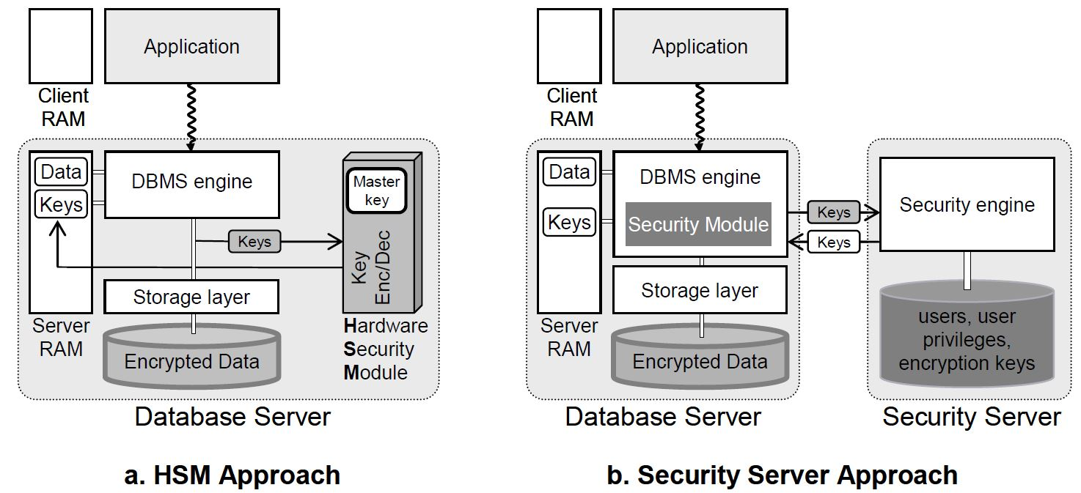
Key Management
Key Management Approaches

Slide 25
Application
Data Encryption within Database (Native Database Encryption)
Oracle
Microsoft SQL Server
MySQL
Data Encryption outside Database (Third-Party Vendors’ Encryption)

Slide 26
Application
Oracle
Dbms_Obfuscation_Toolkit Package
Dbms_Crypto Package
Transparent Data Encryption (TDE)

Slide 27
Oracle
Dbms_Obfuscation_Toolkit Package
Introduced in Oracle 8i
Uses DES algorithm
Now often uses 3DES to do encryption

Slide 28
Oracle
Dbms_Crypto Package
Released in Oracle 10.1
Supports AES
Provides automatic padding
Different options for block chaining
Support for CLOB and BLOB
Will deprecate dbms_obfuscation_toolkit

Slide 29
Oracle
Before using Dbms_Crypto, VARCHAR2 needs to use the UTL_I18N.STRING_TO_RAW function to convert to RAW type.
Convert VARCHAR2 to RAW:
1. Convert VARCHAR2 in the current database character set to VARCHAR2 in the AL32UTF8 database character.
2. Convert VARCHAR2 in the AL32UTF8 database character set to RAW.
UTL_I18N.STRING_TO_RAW (string, 'AL32UTF8');
Convert RAW to VARCHAR2:
1. Convert RAW to VARCHAR2 in the AL32UTF8 database character set.
2. Convert VARCHAR2 in the AL32UTF8 database character set to VARCHAR2 in the database character set you wish to use.
UTL_I18N.RAW_TO_CHAR (data, 'AL32UTF8');
Dbms_Crypto Package Conversion Rules

Slide 30
Transparent Data Encryption(TDE)
Oracle
Introduced in Oracle 10.2
– column encryption
Enhanced in Oracle 11.1
- tablespace encryption

Slide 31
Oracle
Encryption algorithms | Hashing Algorithms (optional)
AES Key length: 128, 192, 256 bits | SHA-1 Digest length: 160 bits
3DES Key length: 168 bits
Standard Encryption Algorithms Used By TDE

Slide 32
How is TDE Implemented?
Oracle
1 Setup Wallet and Master Key
2 Identify columns with sensitive data
3 Review constraints
4 Encrypt existing and new data

Slide 33
Oracle
Two more part must be encrypted:
Set a TNS Listener password and encrypt to prevent unauthorized administration
By default, the TNS Listener has no password set
Enable database link login encryption.
The SYS.LINK$ table contains credentials for remote database servers.
Tips

Slide 34
Microsoft SQL Server
In SQL Server 2000 or older version, there is no encryption package or function.
Now, there are two types:
Column-level Encryption (SQL Server 2005)
SQL Server TDE (SQL Server 2008)

Slide 35
Microsoft SQL Server
EncryptByCert() and DecryptByCert(), which use the public key of a certificate to encrypt and decrypt data
EncryptByAsymkey() and DecryptByAsymkey (), which use an asymmetric key to encrypt and decrypt data
EncryptByKey() and DecryptByKey (), which use a symmetric key to encrypt and decrypt data
EncryptByPassphrase() and DecryptByPassphrase(),which uses a passphrase to generate a symmetric key to encrypt and decrypt data
Decryptbykeyautoasymkey(), which decrypts data by using a symmetric key that's automatically decrypted with an asymmetric key
Decryptbykeyautocert(), which decrypts data by using a symmetric key that's automatically decrypted with a certificate
Column-level Encryption

Slide 36
Microsoft SQL Server
SQL Server TDE encrypts the data before it's written to disk and decrypts it before it is retrieved. This process is performed at the SQL Server Service layer.
With TED, SQL Server encrypts a database using its database encryption key. This asymmetric key is stored in the database boot record. The database encryption key is encrypted using the server certificate, which is encrypted using the Database Master Key of the master database. The master database's Database Master Key is encrypted using Server Master Key. The Server Master Key is an asymmetric key that's encrypted by the Windows DPAPI. The Server Master Key is automatically created the first time you encrypt something and is tied to the SQL Server Service account.
SQL Server TDE

Slide 37
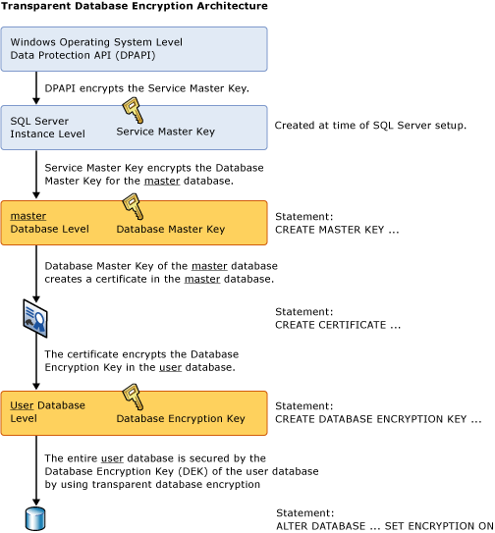
Microsoft SQL Server
SQL Server TDE

Slide 38
Microsoft SQL Server
Steps for using TDE:
Create a master key
Create or obtain a certificate protected by the master key
Create a database encryption key and protect it by the certificate
Set the database to use encryption
SQL Server TDE

Slide 39
MySQL
Name | Description
Aes_Decrypt() | Decrypt using AES
Aes_Encrypt() | Encrypt using AES
Compress() | Return result as a binary string
Decode() | Decodes a string encrypted using ENCODE()
Des_Decrypt() | Decrypt a string (not available in MySQL 5.7.6)
Des_Encrypt() | Encrypt a string (not available in MySQL 5.7.6)
Encode() | Encode a string
Encrypt() | Encrypt a string (not available in MySQL 5.7.6)
Md5() | Calculate MD5 checksum
Old_Password() | Return the value of the pre-4.1 implementation of PASSWORD
Password() | Calculate and return a password string
Random_Bytes() | Return a random byte vector
Sha1(), Sha() | Calculate an SHA-1 160-bit checksum
Sha2() | Calculate an SHA-2 checksum
Uncompress() | Uncompress a string compressed
Uncompressed_Length() | Return the length of a string before compression
Validate_Password_Strength() | Determine strength of password
MySQL Encryption Functions

Slide 40
Third-Party Vendors’ Encryption
Data protection across platforms
protect data within or outside the database
Separation of duties
separation of duties between the system, database and security administrators
Separation of functionality
database do not need for encryption and decryption

Slide 41
Data Encryption’s limitations
Encryption Does Not Solve Access Control Problems
Encryption Does Not Protect Against a Malicious DBA
Encrypting Everything Does Not Make Data Secure

Slide 42
Conclusion
Encryption is the process of obfuscating data by the use of a key or password. This can make the data useless without the corresponding decryption key or password. It is one basic and important method to secure the data. However, there is no perfect application in the world. Each one has its own advantages and disadvantages. When users think about the secure plan, it should be a combination which includes every field.

